Slide 1
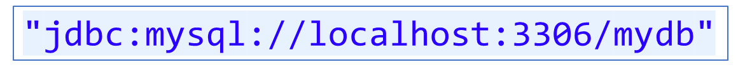
What Programmer does
sets the classpath
For Type4 driver of MySQL
i.e.
com.mysql.cj.jdbc.Driver
Provides Database URL
ss
invokes

Slide 2

What happens when DriverManager.getConnection() gets invoked
ss
Since database URL is for MySQL database, driver for MySQL will be searched in the current class path.
It’s
com/mysql/cj/jdbc/Driver.class
Driver class will be loaded
Driver class contains static block in which , code is written to register Driver with DriverManager.

Slide 3
Driver
registered
DriverManager
acceptsURL
invokes
List of Registered drivers
Returns true
connect
invokes
com/mysql/jdbc/Driver.class
Returns true
Java Application
Returns Connection
con
Used to create statements like Statement, PreparedStatement or CallableStatement

